Slide 1
Builderz

Slide 2

bevezetés
A projekt
Technológiák
AR
Előnyök és Hátrányok
Célcsoport

Slide 3

A projekt
Block Overflow
Készségfejlesztő játék
Valós időben
Kreatív és Challenge mód
Ranglista

Slide 4
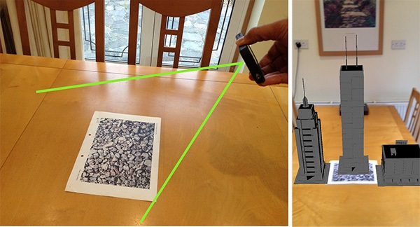
Koncepció

Slide 5
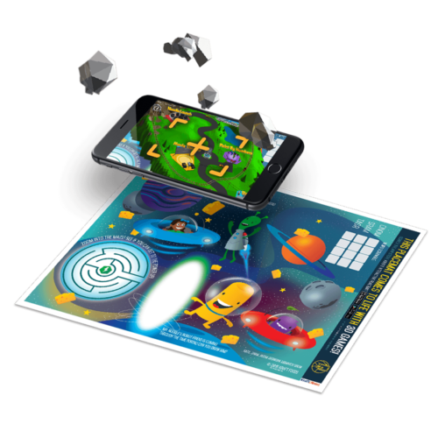

Mik a terveink a projekttel

Slide 6



Felhasznált Technológiák

Slide 7
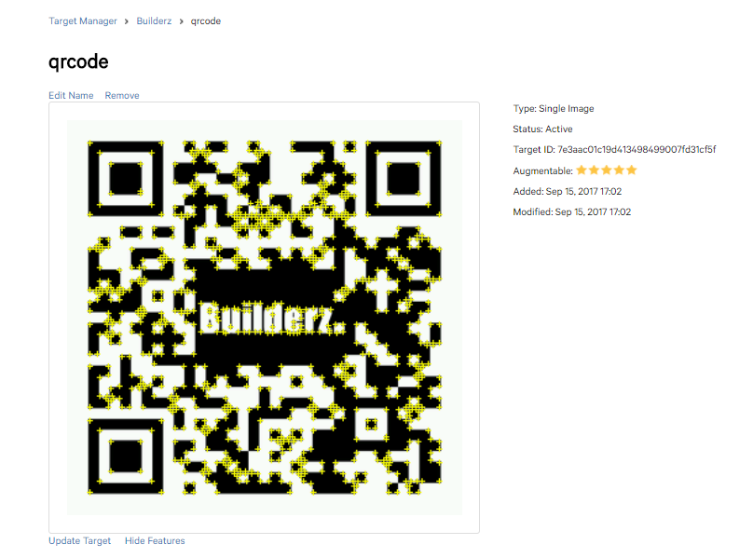
Tracking

Slide 8

Miért Ezeket Használjuk
Hatékony
Licence
Sokoldalúság
Bővíthetőség
Folyamatosan fejlődő technológiák

Slide 9
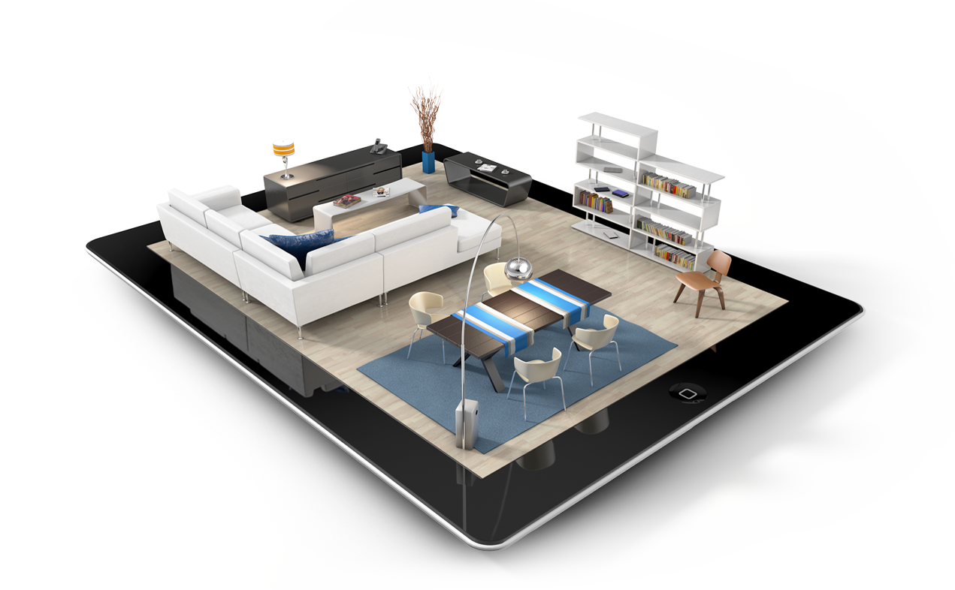
Mi Az AR?
Valós és Virtuális világ kombinálása
Interaktív
Valós idejű
Notes:
Combining the Real and Virtual Worlds
Augmented reality (AR) is a field of computer research which deals with the combination of real-world and computer-generated data. At present, most AR research is concerned with the use of live video imagery which is digitally processed and "augmented" by the addition of computer-generated graphics. Advanced research includes the use of motion-tracking data, fiducial marker recognition using machine vision, and the construction of controlled environments containing any number of sensors and actuators.
Augmented reality (AR) is a field of computer research which deals with the combination of real-world and computer-generated data.
Most of the AR research is currently concerned with the use of video imagery which is digitally processed and augmented by adding computer-generated graphics.
Combines real and virtual world aspects
Is interactive in real-time
Is registered in three dimensions
A combination of
a real scene viewed by a user and
a virtual scene generated by a computer that augments the scene with additional information.
Augmented reality (AR) is a field of computer research which deals with the combination of real-world and computer-generated data. At present, most AR research is concerned with the use of live video imagery which is digitally processed and "augmented" by the addition of computer-generated graphics. Advanced research includes the use of motion-tracking data, fiducial marker recognition using machine vision, and the construction of controlled environments containing any number of sensors and actuators.

Slide 10
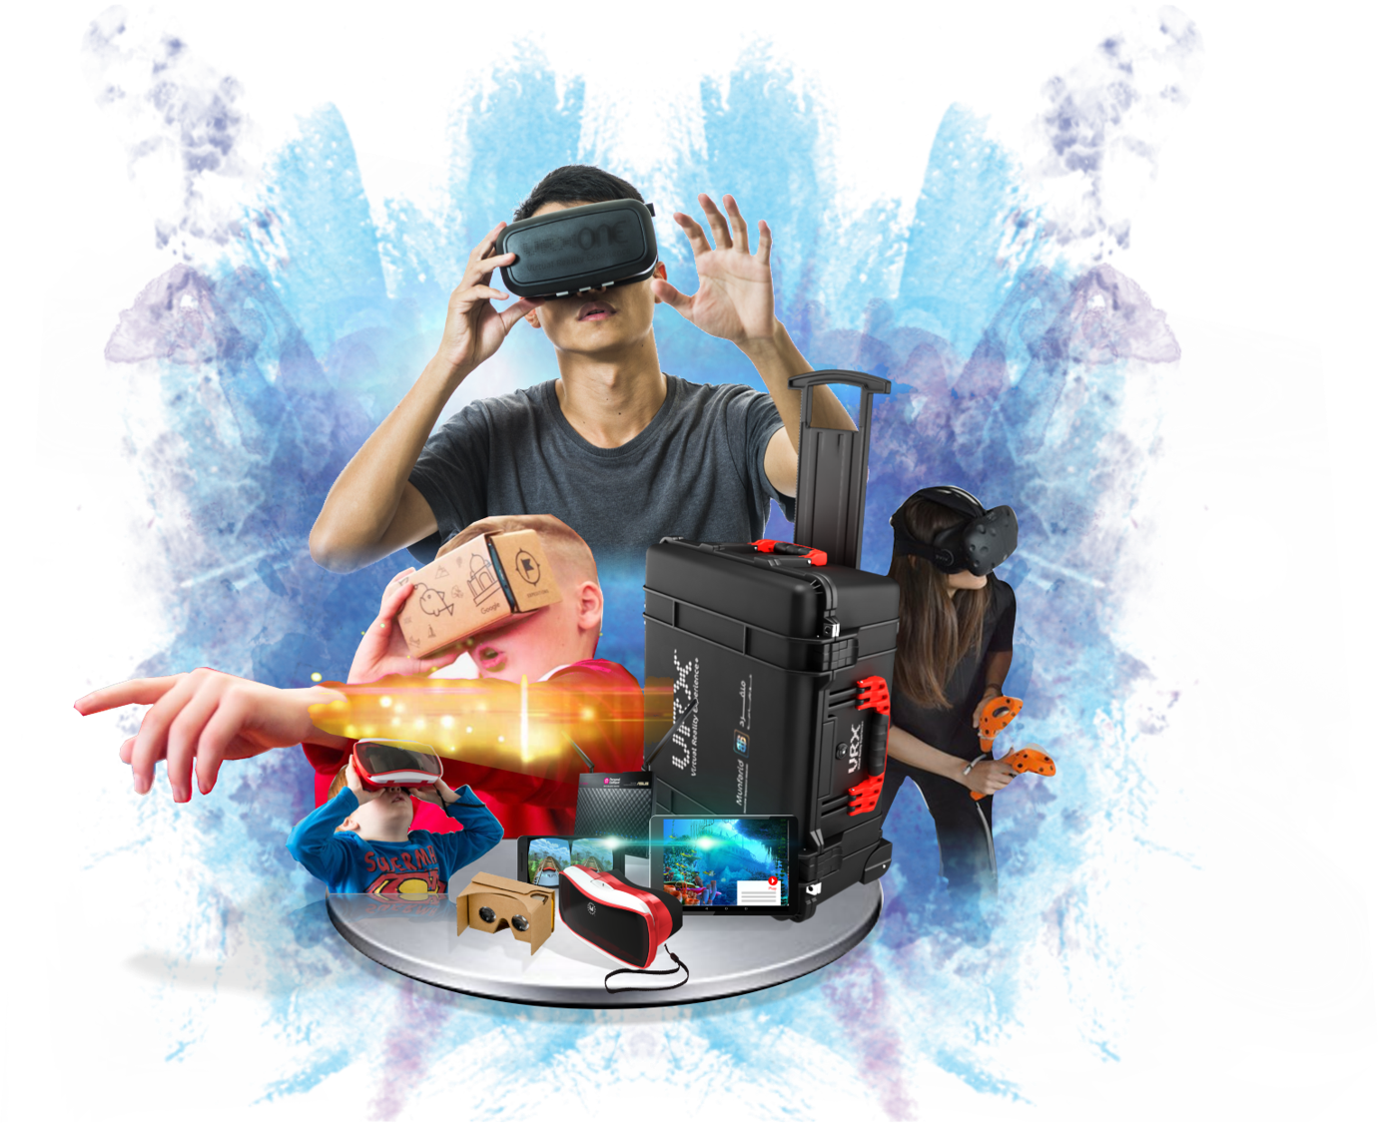

Ar vs VR
Notes:
Virtual Reality (VR)
a computer generated, interactive, 3D environment in which a person is immersed : virtual, interactive and immersive
Augmented Reality (AR)
Supplements the real world with the virtual(computer generated) objects that appear to coexist in the same space as the real world.

Slide 11

Hátrányai
Számításigényes
Pontosság
Kép minősége
Költséges
Notes:
Two performance criteria are placed on the system:
Update rate for generating the augmenting image
Accuracy of the registration of the real and virtual image
Update rate can limit registration accuracy as well
Brooks paper – “1 ms = 1mm error”
Failures in registration due to:
Noise
Position and pose of camera with respect to the real scene
Image distortions
Time delays
In calculating the camera position
Programming Physics
Programmer must be able to write code based on physical input and output
Cost
Currently you can only partner or license with companies like Total Immersion
Under Development
The research is still under development
Graphics
When including more detailed graphics, processing can be more intense

Slide 12

Az ar előnyei
Interaktív
Készségfejlesztő
Valós idejű
Notes:
Combines real-world environments and virtual reality
Real-world environments can interact with virtual objects.
Virtual objects will respond to real-world physical actions.
Interactive in real-time
Real time processing
Data can be generated in real time
Registered in three dimensions
Imagery is in 3D
Graphics and Models are created by Designers
Kézségfejlesztő

Slide 13

Célcsoport
Fiatalok
Felnőttek
Idősek

